Slide 1
Pulitzer clustering using machine learning
Final Report - 7th Jan 2018
By: Subir Das

Slide 2
Objective, Clients and Goal
Objective:
As we all know that “Democracy Dies in Darkness^{1*}” and “Truth is hard to Find^{2*”} are the cornerstone of the economy. With this mind, the goal is to identify different types of Newspapers Segments based on Pulitzer prize and then identify ways to increase daily circulations by improving visibility and gaining new insights. It may also act as a catalyst for further boosting readers confidence in the print media.
Clients:
Print Media like New York Times (www.nytimes.com) and Machine Learning Community.
Goal:
Increase daily circulations and gaining new insights by identifying patterns thus further improving readers’ confidence in the print media.
Credit and Copyrights:
1 – Washington Post and 2– New York Times hold the respective copyright and credits.
* Source Internet

Slide 3
Data Source
The data for this project is collected from different internet resources as listed below. The base data also called raw data (“Pulitzer Dataset”) is made available by FiveThirtyEight. It is a simple table mapping newspaper with daily circulation and Pulitzer. Pulitzer Dataset is combined with many other dataset in order to find socioeconomic correlations. Additional data source and their formats are described below.
Additional Data Sources used:
Raw Data is made available by FiveThirtyEight. https://github.com/fivethirtyeight/data/blob/master/pulitzer/pulitzer-circulation-data.csv
Crime Data by State and US: The idea is to check if there is any correlation between crime rate and Pulitzer. The dataset is made available by US Departments.
http://www.usa.com/rank/us--crime-index--state-rank.htm: The data is a simple excel sheet mapping crime index to US state by population.
https://ucr.fbi.gov/crime-in-the-u.s/2014/crime-in-the-u.s.-2014/tables/table-1 : This is also an excel sheet mapping year, US population to crime index and types of crime

Slide 4
Data Contd…
Additional Data Sources used:
GDP for US and States: https://www.usgovernmentrevenue.com/download_multi_year_2000_2014USb_19c1li101mcn_F1cF0t: This is a CSV file mapping GDP by state by year dataset. We have 50+1+1 such files.
Population by State and US: https://www.census.gov/data/datasets/2016/demo/popest/state-total.htm : This is also an excel based data file mapping US stats to population to year. We have two files to cover 22 decades i.e. 1 file per census.

Slide 5
Solution Approach
Machine Learning: K-Means and PCA to help with the dimension reduction and newspapers’ segmentation.
The solution approach is specifically designed to achieve a controlled and structured approach to minimize data quality issues that may be present or introduced to protect personally identifiable information(PII). The solution is sub-divided into three phases as listed below.
Phase I
Get Data
Review Literature
Design Evaluation Matric
Phase II
Explore Data
Pre-processing
Phase III
Modelling

Slide 6
Solution Approach…
Data Assembly - Phase I: This phase of the project is designed to gather and do basic cleanup like join, merge, add or update attributes.
Explore and Preprocessing – Phase II: This phase of the project is designed to validate and explore the dataset for all the problems listed in the “Problem” section of this proposal.
Modelling and Evaluation Phase III: In this phase of the project I will be exploring various machine learning algorithms to find the best model to cluster the newspapers.
Technology Stack: Cassandra, Google Cloud Platform, Python, MS-Excel, Atom
Configuration Management System: GitHub
Testing and Traceability: IPython Notebook

Slide 7
Data Wrangling – Phase I
Final Dataset:
The final Pulitzer dataset went through industry standard data validation and verification(V&V) along with transformation before it was used for exploration and pre-processing. The final dataset was created after merging and transforming 58 datasets. For Audit, timestamp and unique identification(UUID) was added to all the 58 pandas dataframes. And to make it persistent and reproducible, domain level information was stored in Cassandra cluster running in Google Cloud. Please see the below list for different type of operations as performed.
Pulitzer Dataset (1 data table) : Datatype Conversion, Removing special char {, % / \} , pandas.join|merge|concat|pivot
Crime Data ( 2 Data tables): Missing Values, Datatype Conversion, Column Hacks
GDP for US and States (53 Data tables) : CSV Bad Lines, Missing Data, Column Hacks, pandas.join|merge
Population by State and US (2 Data tables) : Selective columns reading, Datatype Conversion
Wrangling Highlights:
Google Cloud Platform and Multi Threading to handle massive volume of data
Cassandra Storage for Persistency and Reproducibility
Audit details for Traceability

Slide 8
Data Exploration – Phase II
Based on initial data review, it appears that we have outliers and Pulitzer data tends to follow a 80-20 rule i.e. 80% of the newspaper population is under 10 Pulitzer Prizes and 20% of the population is above 10 Pulitzer Prizes.

Slide 9
Data Exploration – Phase II
It appears that we have positive relationship between Crime Index, US GDP and Daily Circulation not with Violent Crime.

Slide 10
Data Exploration – Phase II
Summary Statistics:
Mean : 15.06
Variance : 595.0164
Skewness: 2.8072431554058634
Kurtosis : 7.563560952747379
Median: 7.0
pValue: 1.5546437888e-11
Observation: It looks like that Pulitzer Data is not a normal distribution. This makes sense as Pulitzer is a highly respected price.

Slide 11
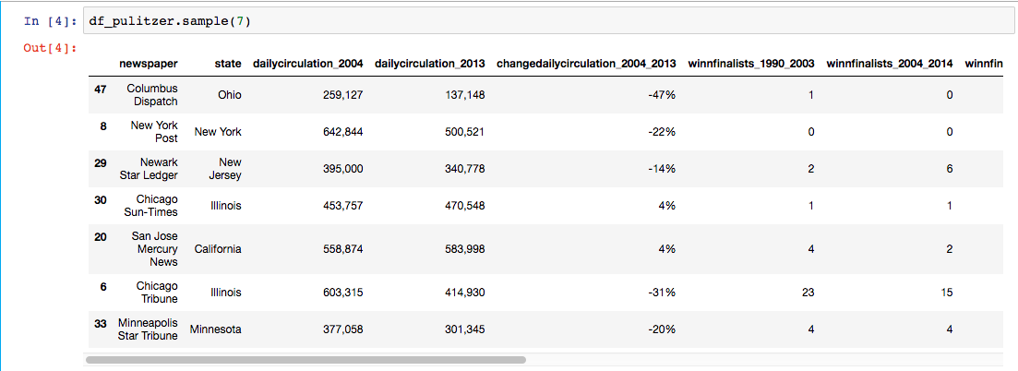
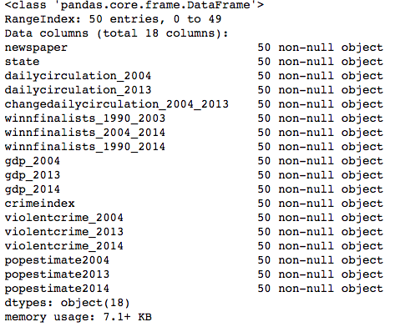
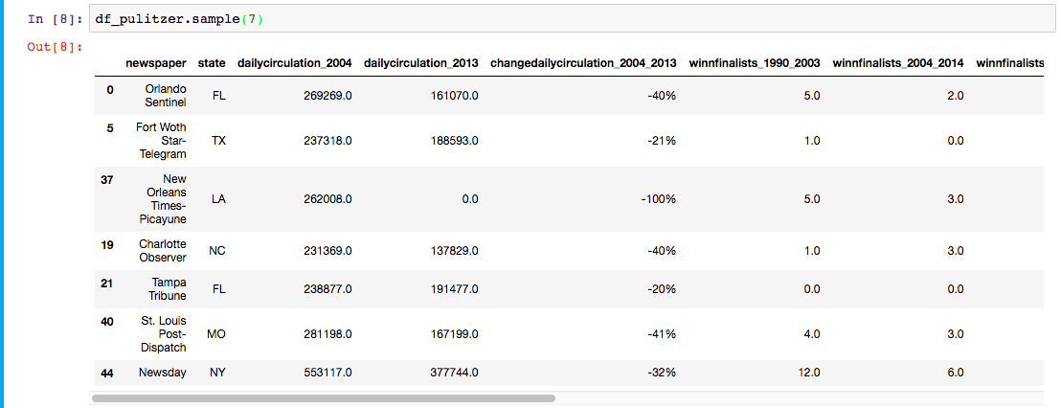
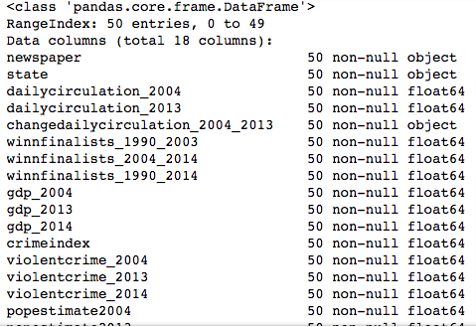
Modeling – Phase III – K- Means and PCA
The data was prepared by removing commas, changing datatypes and US state name to two digit code. Please see the below snips for details.
Before pre-processing:
After pre-processing:
K-Means and PCA to help with the newspapers’ segmentation and dimension reduction.

Slide 12
Modeling – Phase III – K- Means and PCA
K-Means and PCA to help with the newspapers’ segmentation and dimension reduction.
K-Means: We plan to use the K-Means Clustering to maximize the distance between centroids and minimize the distance between data points and the respective centroid for the cluster they are in.
from sklearn.cluster import Kmeans
Ks=range(2,11)
inertias = []
for k in Ks:
model = KMeans(n_clusters=k)
model.fit(X)
inertias.append(model.inertia_)
Observation:
We can see that between K=4 and K=5 the error did not drop significantly. We can safely select K=4 as our best case value of k for K-Means clustering algorithm.

Slide 13
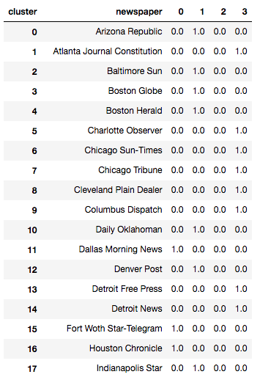
Modeling – Phase III – K- Means and PCA
PCA: We plan to use the same number of components as K-Means i.e. 4.
from sklearn.decomposition import PCA
pca = PCA(n_components =4)
pca.fit(X)
pca_features=pca.transform(X)
df_pulitzer['x']=pca_features[:,0]
df_pulitzer['y']=pca_features[:,1]
df_result=df_pulitzer.groupby(['cluster','newspaper'])['state'].count().unstack('cluster')
df_result = df_result.fillna(0).reset_index()
Conclusion:
We have mapped the newspapers into 4 clusters based on Crime, GDP, Population and Pulitzer.

Slide 14
Summary and Next Steps
Summary:
The clustering model was designed to produce cluster of newspapers based on Crime, GDP, Population, Daily Circulation and Pulitzer. It was tested and statistically proved that Pulitzer price do not follow a Normal Distribution, which makes perfect sense else it will be easy to predict prices. The clustering of the newspaper seems to suggest that print media clusters try to form around highly dense population.
A cluster size of 4 for K-Mean was our best size.
A component of 4 was our best size for PCA
Pulitzer Data is NOT normally distributed
Next Steps:
The identified newspaper cluster model needs analysis using Graph(network analysis) for finding the economic zones. It should be further be extended to cluster newspaper Article SOURCE for pattern recognition followed by a ML classification (chaining model outputs/logistic regression) to boost news quality.

